Slide 1
Big Sales Prediction
CAPSTONE PROJECT
Presented By:
Nagilla Shyam Kumar
- Brilliant Grammar School Educational Society’s Group of Institutions
- CSE(Data Science)

Slide 2
OUTLINE
Problem Statement
Proposed System/Solution
System Development Approach
Algorithm & Deployment
Result
Conclusion
Future Scope
References

Slide 3
Problem Statement
Accurately predicting big sales is a significant challenge for businesses aiming to optimize inventory, allocate resources efficiently, and maximize revenue. Sales can be influenced by numerous factors, including seasonality, economic conditions, marketing campaigns, and consumer behavior.
To tackle this problem, the project proposes the development of a predictive model using advanced machine learning techniques, such as Random Forest Regression. This model will analyze historical sales data and relevant external variables to forecast future sales, thereby enabling businesses to make data-driven decisions and improve their strategic planning.

Slide 4
Proposed Solution
To address the challenge of accurately predicting big sales, we propose developing a machine learning model using Random Forest Regression. The solution involves several key steps:
Data Collection: Gather comprehensive historical sales data, along with relevant factors such as pricing, promotions, economic indicators, and seasonality.
Data Preprocessing: Clean and preprocess the data, including handling missing values, normalizing data, and feature engineering.
Model Development: Train a Random Forest Regression model on the processed data. This algorithm is chosen for its ability to handle large datasets and complex relationships.
Model Evaluation: Assess the model's performance using metrics such as Mean Absolute Error (MAE), Root Mean Squared Error (RMSE), and R² score.
Deployment: Implement the model in a real-time sales forecasting system, enabling businesses to use predictions for inventory management, marketing strategies, and overall operational planning.

Slide 5
System Approach
System Requirements:
Hardware: High-performance computing environment to handle large datasets.
Software: Python, Jupyter Notebook/Google Colob.
Libraries used:
Libraries such as Pandas, Numpy, Scikit-Learn, Seaborn, and Matplotlib.

Slide 6
Algorithm & Deployment
Algorithm Selection:
We use Long Short-Term Memory (LSTM) networks for big sales prediction due to their strength in capturing complex temporal patterns and long-term dependencies in time-series data.
Data Input:
The model uses historical sales data, promotional activities, economic indicators, and seasonal trends as input features.
Training Process:
LSTM is trained on historical data with techniques like cross-validation and hyperparameter tuning to optimize performance and avoid overfitting.
Prediction Process:
The trained LSTM makes future sales predictions by integrating historical data with real-time inputs, ensuring accurate and timely forecasts.

Slide 7
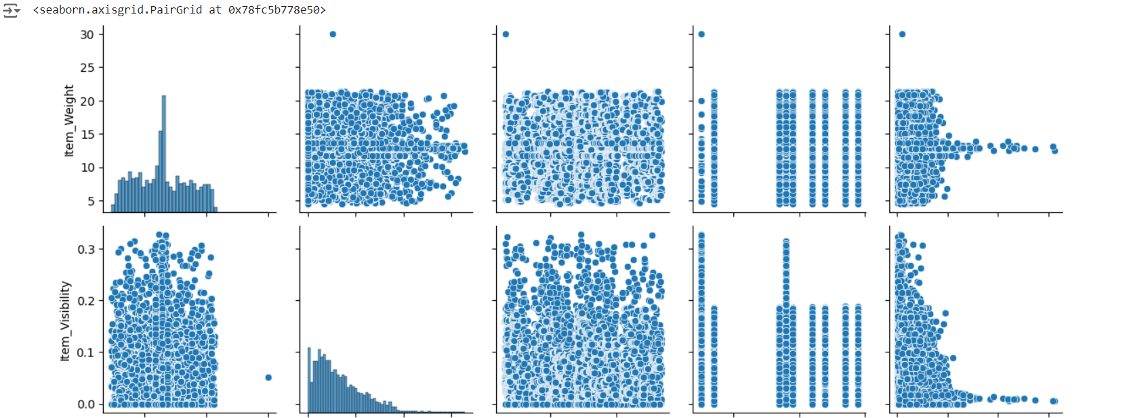
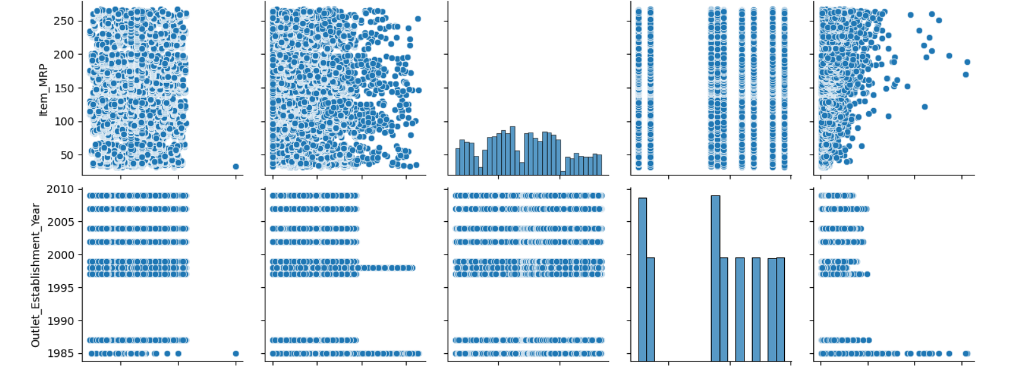
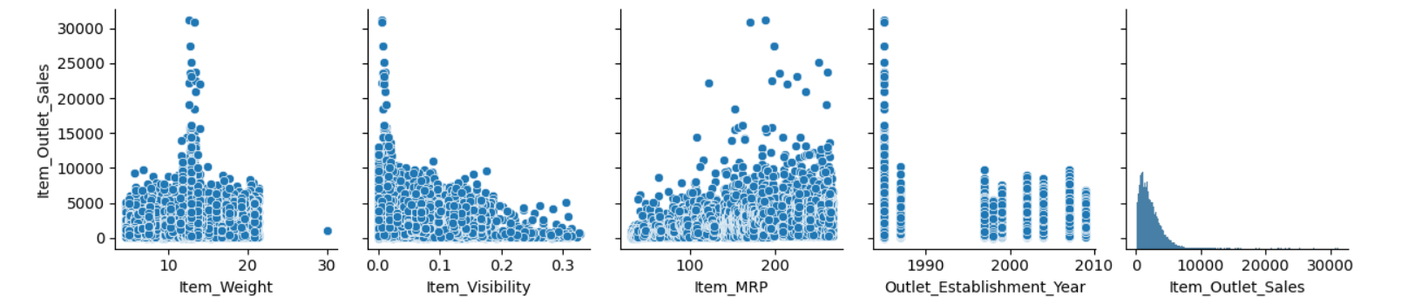
Result
Performance Metrics:
Mean Squared Error (MSE): 1613965.15465047
Mean Absolute Error (MAE): 827.783002565394
R-squared (R²): 0.5799088331861746

Slide 8
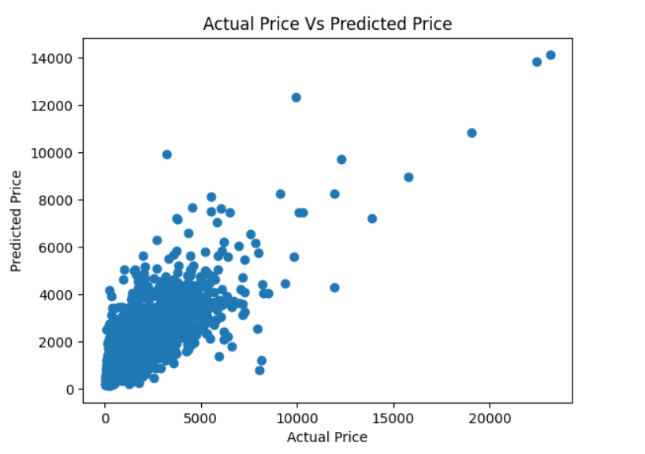
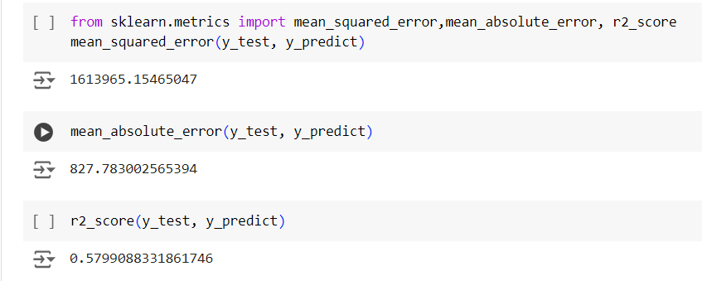
Result
Data visualization:

Slide 9
Conclusion
The Big Sales Prediction project highlights the significant role of data-driven decision-making in enhancing retail operations. By leveraging historical sales data and applying advanced machine learning techniques, the project successfully developed predictive models that provide accurate sales forecasts. These insights enable Big Mart to optimize inventory management, refine pricing strategies, and tailor marketing efforts, ultimately leading to improved customer satisfaction and competitive advantage.

Slide 10
Future scope
Future research could focus on incorporating real-time data and exploring more sophisticated algorithms to further improve the robustness of sales predictions. Overall, this project demonstrates the transformative potential of machine learning in the retail sector, paving the way for more efficient and responsive business practices.

Slide 11
References
References:
Big Sales Prediction Dataset
Retrieved from GitHub repository: https://github.com/YBI-Foundation/Dataset/raw/main/Big%20Sales%20Data.csv
OpenAI. (2024). Assistance In Model Selection. Retrieved from https://www.openai.com
Python Libraries: Seaborn, Matplotlib. Documentation retrieved from https://seaborn.pydata.org.
and https://matplotlib.org.
Project link: https://colab.research.google.com/drive/1AWn1kdERC7MFBbV5y92dJfCehlRwE97O?usp=sharing

Slide 12
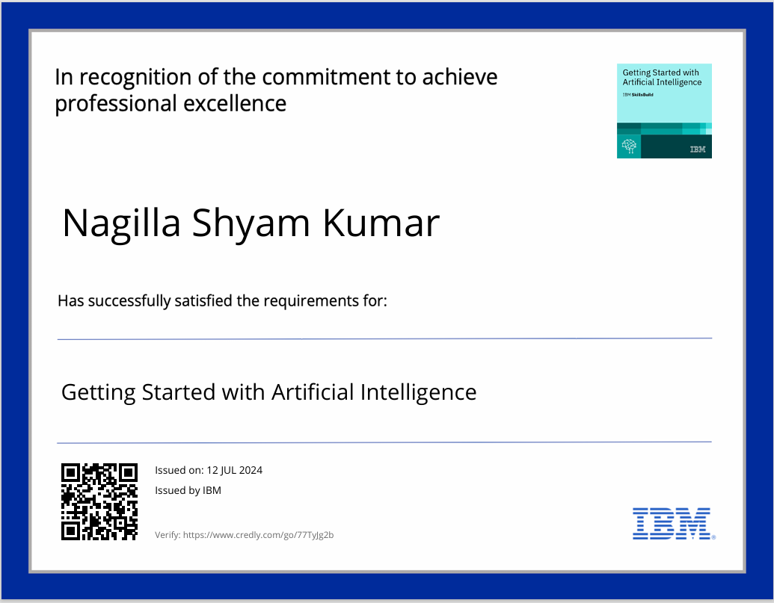
course certificate 1

Slide 13
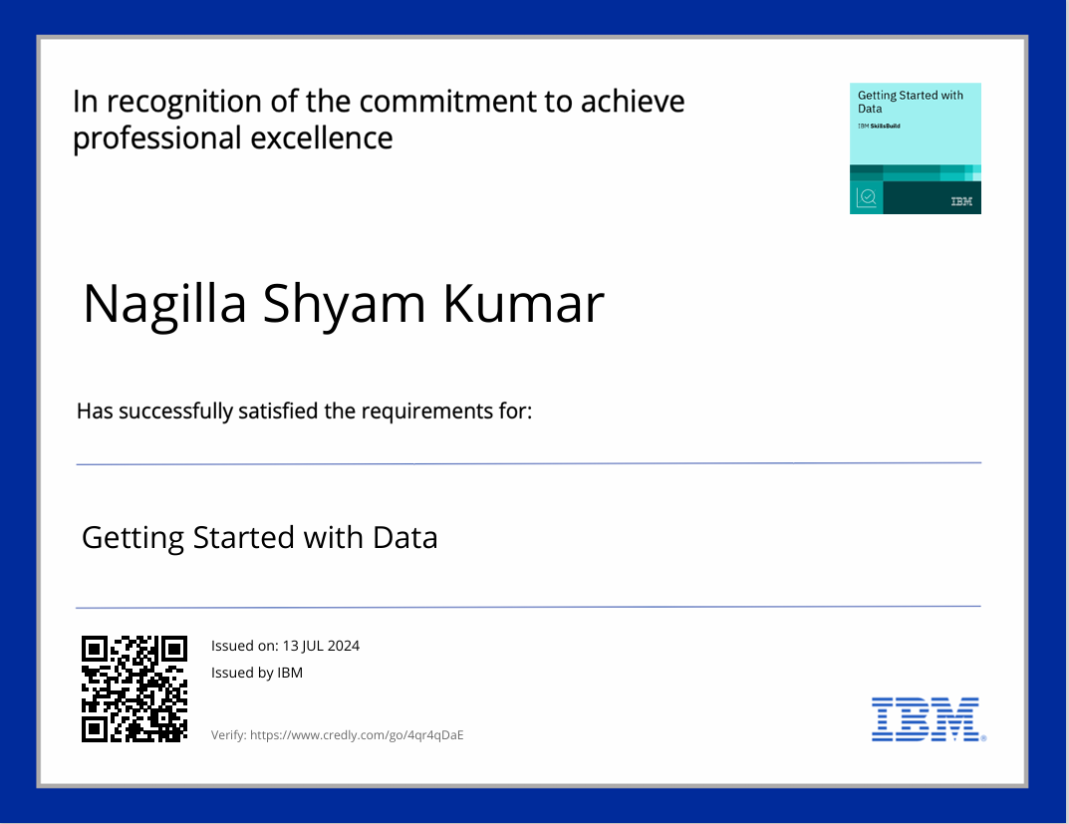
course certificate 2

Slide 14
THANK YOU

